Slide 1

Leveraging NLP for Effective Cyberbullying Detection
By: Abdul Karim Shaikh

Slide 2

Introduction
Cyberbullying is a serious problem affecting many people, especially young individuals. Natural Language Processing (NLP) can be a powerful tool to help detect and prevent it. This presentation will explore how NLP can be used for effective cyberbullying detection.

Slide 3

What is Cyberbullying?
Cyberbullying involves the use of technology (such as social media or text messaging) to harass, humiliate, or intimidate others. It can have serious consequences for the victim's mental health and well-being. Cyberbullying can take many forms, including name- calling, spreading rumors, or even threatening physical harm.

Slide 4

^{The Power of N}LP
^{Natural Language Processing (}NLP) is ^{a ﬁeld of study that focuses} on the ^{interaction between comput}ers and ^{human language. NLP can} help us analyze and understand large volumes of text data, making it a valuable tool for detecting cyberbullying. With NLP, we can identify patterns of language use that may indicate cyberbullying, such as
^{the use of derogatory te}rms or ^{threatening lang}uage.

Slide 5

Challenges of Cyberbullying Detection
Cyberbullying can be difﬁcult to detect because it often involves subtle forms of harassment or intimidation. For example, a message that seems innocuous on the surface may actually be intended to hurt or humiliate the recipient. In addition, cyberbullying can take many different forms and can be difﬁcult to distinguish from other types of online behavior.

Slide 6
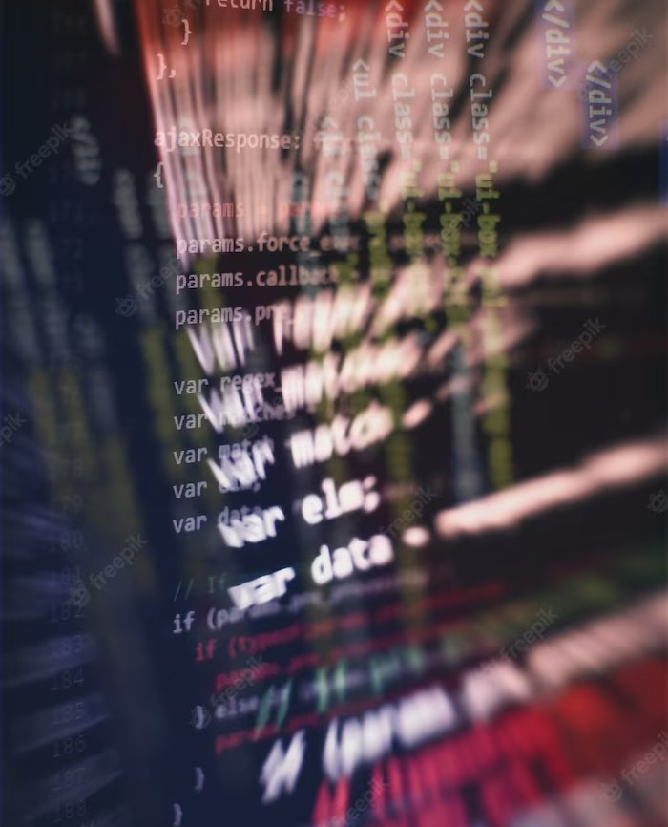
NLP Techniques for Cyberbullying Detection
There are several NLP techniques that can be used for cyberbullying detection, including sentiment analysis, named entity recognition, and topic modeling. Sentiment analysis can help us identify messages that contain negative or threatening language, while named entity recognition can help us identify the people or organizations involved in cyberbullying incidents. Topic modeling can help us identify the themes or topics that are most commonly associated with cyberbullying.

Slide 7

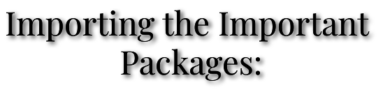
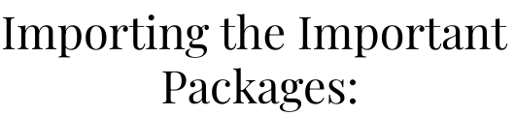
This section imports various libraries and packages required for the code e ecution. These include pandas, re (regular
e pressions), nltk (Natural Language Toolkit), scikit-learn, matplotlib, seaborn, spacy, gensim, pyLDAvis, tqdm, and others.

Slide 8
GENSIM
PyLDAvis
PyLDAvis is a Python library that provides an interactive visualization tool for topic models created with Gensim. It allows you to visually
Gensim is a Python library speciﬁcally designed for topic modeling and document similarity analysis. It provides an easy-to-use interface to implement algorithms for unsupervised semantic modeling.
Gensim supports various topic models, including Latent Dirichlet Allocation (LDA), Latent Semantic Analysis (LSA), and Random Projections.
With Gensim, you can build topic models from te t
data, e tract topics from documents, and perform similarity queries between documents. It also oIers functionalities for document clustering, word vector representation, and word embedding models such as Word2Vec.
^{e plore and interpret the resu}lts of topic
mo
deling. PyLDAvis helps in understanding the
underlying topics, their keywords, and the relationship between topics and documents.
Using PyLDAvis, you can generate interactive
vi
sualizations that display topics as bubbles, with
the bubble size indicating the prevalence of the topic. The visualization also shows a set of representative terms for each topic and their relevance scores. Additionally, PyLDAvis oIers an interactive document display, allowing you to
^{e plore the distribution of to}pics within
^{individual d}ocuments.

Slide 9

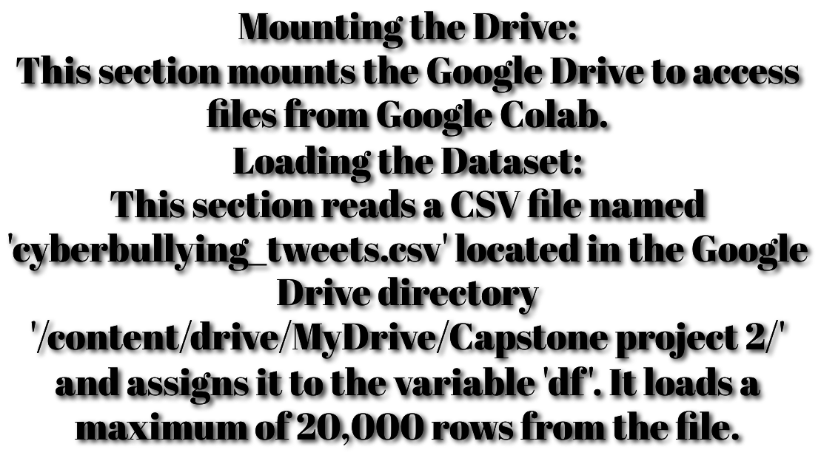
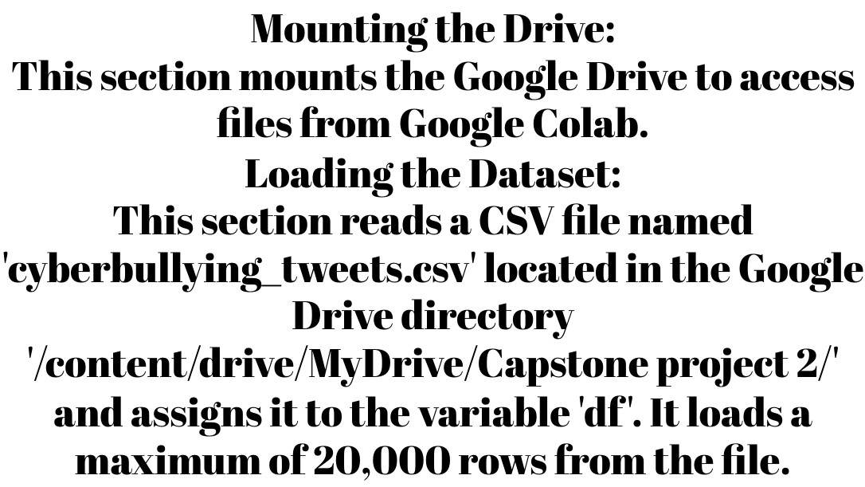
MOUNTING AND LOADING THE DATASET

Slide 10

Preprocessing the Data
This section focuses on preparing the loaded data for analysis. It includes the following steps: Handling Null Values: It checks for null values in the DataFrame and identiﬁes columns with missing data.
Handling Duplicate Values: It identiﬁes and handles any duplicate rows in the DataFrame. Class Distributions: It analyzes the distribution
of diIerent classes (cyberbullying types) in the dataset.
Word Count: It calculates the frequency of each word in the dataset after removing common stop words.

Slide 11

Visualization
This section includes various visualization techniques applied to the dataset:
Word clouds: It generates a visual representation of
the most frequently occurring words in the dataset. Sentiment Analysis Plot: It performs sentiment analysis on the tweet te ts and plots the distribution of polarity (positive or negative sentiment) and subjectivity (subjective or objective nature) scores.
Named Entity Recognition (NER) Plot: It identiﬁes and visualizes named entities (such as person names, organizations, locations) in a sample tweet.
Part-of-Speech (POS) Tagging Plot: It performs POS tagging on a sample tweet and visualizes the relationships between words.
Topic Modeling Visualization: It applies topic modeling techniques using Latent Dirichlet Allocation (LDA) on the tweet te ts and visualizes the discovered topics.

Slide 12
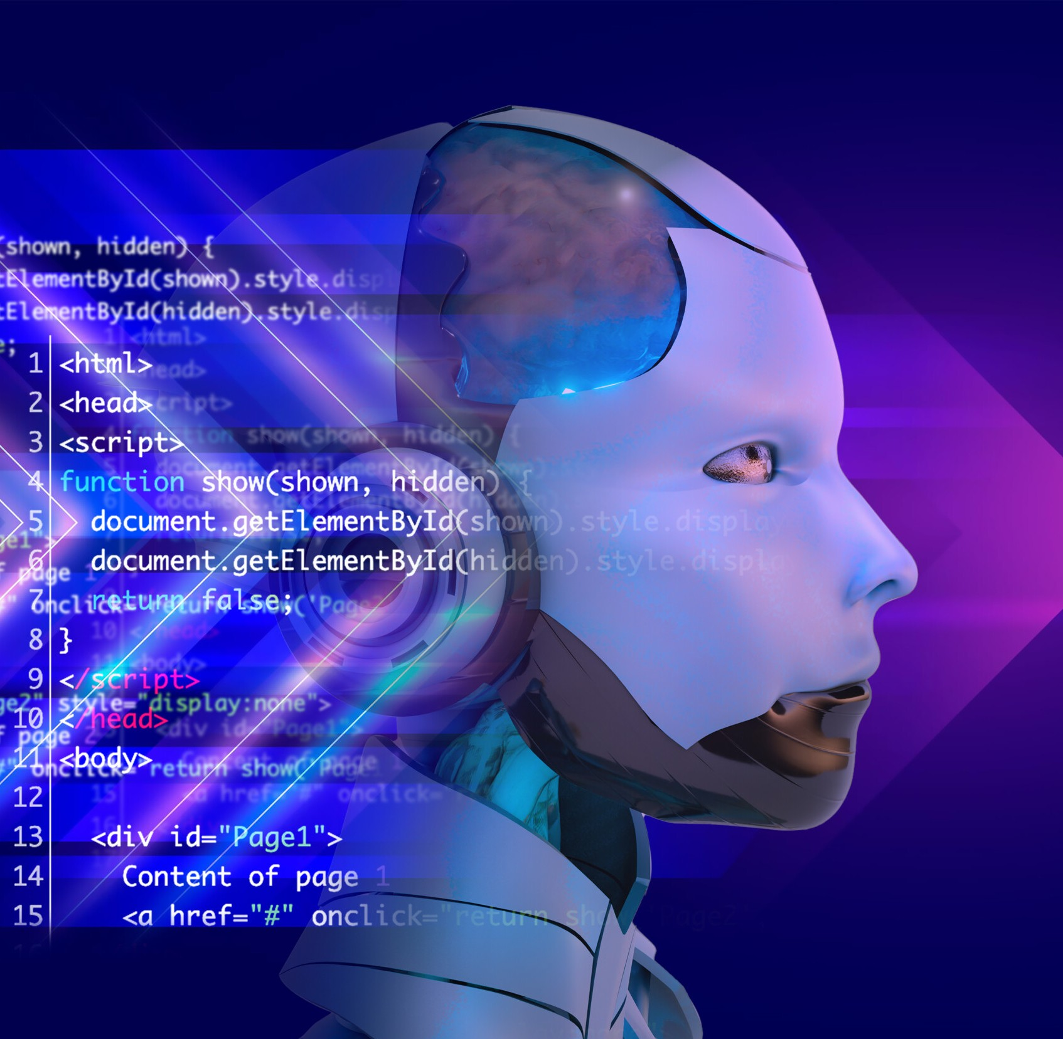
Natural Language Processing (NLP)
This section focuses on te t data preprocessing and feature e traction using the Bag of Words model:
Data Cleaning: It cleans the tweet te ts by removing HTML tags, non-alphabetic characters, URLs, mentions, hashtags, and stop words. It also performs tokenization and stemming to reduce words to their base form.
Feature Etraction: It creates a Bag of
Words model using CountVectorizer to convert the cleaned te t data into a numerical representation that can be used for machine learning.

Slide 13


Classiﬁcation Model
This section trains a logistic regression model using the preprocessed and feature-e tracted data:
Logistic Regression Model: It creates an instance of the logistic
regression model and ﬁts it to the training data.
Predictions: It uses the trained model to predict the class labels for the test data.
Accuracy Score: It calculates the accuracy of the model by comparing the predicted labels with the actual labels.
Confusion Matri : It creates a confusion matri to evaluate the performance of the classiﬁcation model.
Classiﬁcation Report: It generates a detailed report that includes precision, recall, F1-score, and support for each class label.

Slide 14
Conclusion
In summary, the code performs a series of tasks including data loading, preprocessing, visualization, natural language processing (NLP), and classiﬁcation modeling to analyze a dataset of cyberbullying
Cyberbullying is a serious problem that can have long-lasting effects on its victims. NLP can be a powerful tool for detecting and preventing cyberbullying by analyzing large volumes of text data. By leveraging the power of NLP, we can work together to create a safer and more welcoming online environment for everyone.

Slide 15
Thanks!

